Slide 1

Indian Institute of Technology Kharagpur, India | Centre of Excellence in Artificial Intelligence
Multimorbidity Image Retrieval Using Deep Neural Hashing on NIH Chest X-ray
04 February 2022
CT Sinogram Denoising | Asim Manna

Slide 2
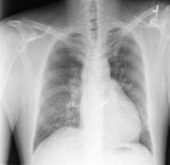




Indian Institute of Technology Kharagpur, India | Centre of Excellence in Artificial Intelligence
Preamble
$$ℝ^{M×M}$$
$$ℝ^{64×1}$$
$$ℝ^{K×1}$$
netf (.)
fc(.)
Tanh(.)
$$X_{i}$$
04 February 2022
Hashing for multimorbidity| Asim Manna

Slide 3
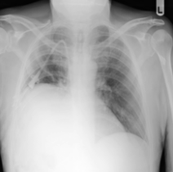
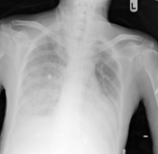
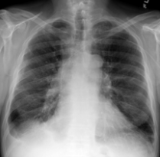

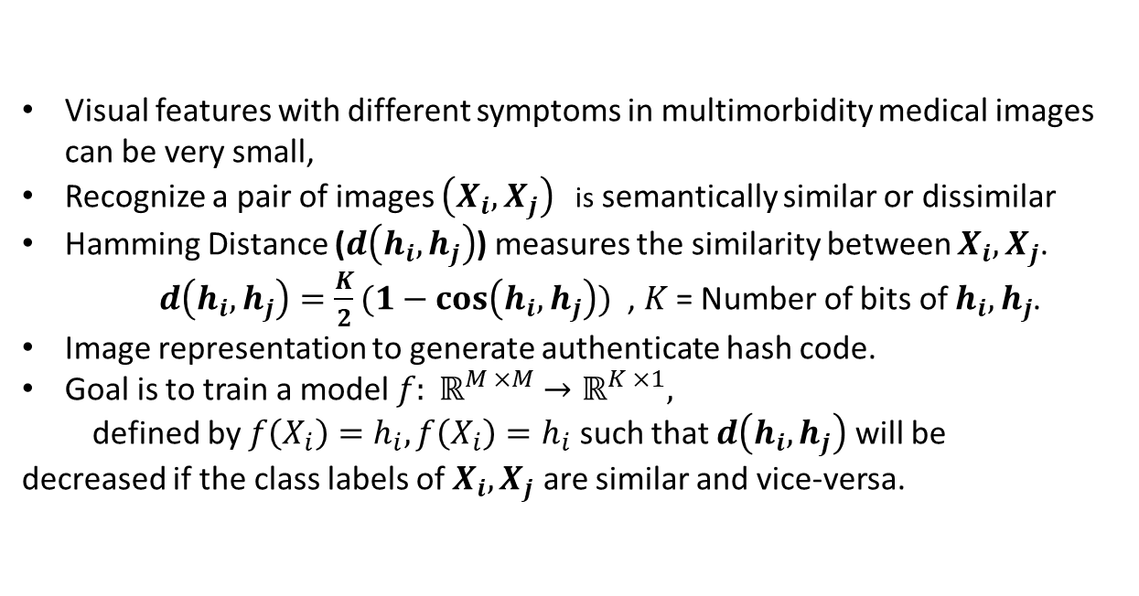







Indian Institute of Technology Kharagpur, India | Centre of Excellence in Artificial Intelligence
Challenges
Visual features with different symptoms in multimorbidity medical images can be very small,
Recognize a pair of images $\left(X_{i}, X_{j}\right)$ is semantically similar or dissimilar
Hamming Distance ($d\left(h_{i}, h_{j}\right)$) measures the similarity between $X_{i}, X_{j}$. $d\left(h_{i}, h_{j}\right)=\frac{K}{2}(1−\cos\left(h_{i}, h_{j}\right))$ , $K$ = Number of bits of $h_{i}, h_{j}$.
Image representation to generate authenticate hash code.
Goal is to train a model $f: ℝ^{M ×M}→ℝ^{K ×1},$
defined by $f\left(X_{i}\right)=h_{i},f\left(X_{i}\right)=h_{i}$ such that $d\left(h_{i}, h_{j}\right)$ will be decreased if the class labels of $X_{i}, X_{j}$ are similar and vice-versa.
$$X_{i}$$
$$d\left(h_{i}, h_{j}\right)$$
$$d\left(h_{i}, h_{j}\right)$$
Atelectasis
Effusion | Infiltration
$$X_{j}$$
Atelectasis
$$X_{n}$$
Atelectasis | Effusion
$$d\left(h_{i}, h_{j}\right)$$
$$d\left(h_{i}, h_{j}\right)$$
$$X_{m}$$
04 February 2022
Hashing for multimorbidity | Asim Manna

Slide 4
Indian Institute of Technology Kharagpur, India | Centre of Excellence in Artificial Intelligence
Solution
Contains three steps
Minimizing multi-label classification loss
Label thresholding using label co-occurrence matrix
Minimizing similarity loss depends on threshold value
04 February 2022
CT Sinogram Denoising | Asim Manna

Slide 5
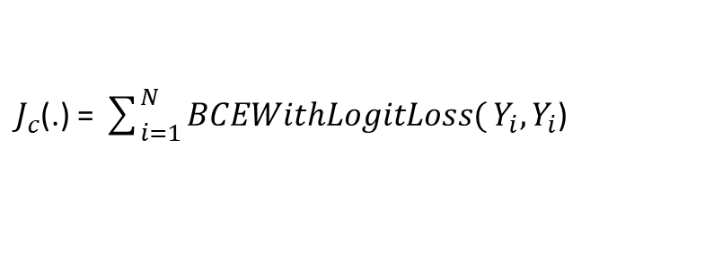
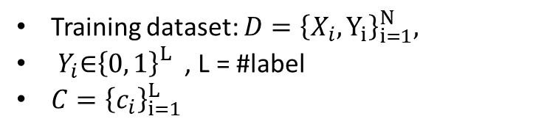

Indian Institute of Technology Kharagpur, India | Centre of Excellence in Artificial Intelligence
Solution
Multi-label classification loss
Training dataset: $D={\left\{X_{i}, Y_{i}\right\}}_{i=1}^{N},$
$Y_{i}\text{∈}{\left\{0, 1\right\}}_{}^{L}$ , L = #label
$C={\left\{c_{i}\right\}}_{i=1}^{L}$
netf (.)
fc(.)
$$X_{i}$$
$J_{c}$(.) = $\sum_{i=1}^{N}{BCEWithLogitLoss(}Y_{i},Y_{i}$)
04 February 2022
Hashing for multimorbidity | Asim Manna

Slide 6

Indian Institute of Technology Kharagpur, India | Centre of Excellence in Artificial Intelligence
Solution
Label thresholding using label co-occurrence matrix
Label co-occurrence matrix, ${\left(W\right)}_{L×L}={\left\{w_{ij}\right\}}_{i,j}$ , $∀ i, j = \{1, 2,….,L\}$
= the number of images of class $c_{i}, c_{j}$ occurred together in dataset
Threshold value, t = mean of $w_{ij}$ i, j = {1, 2,….,L}
Define, $W_{t}=\{\left(c_{i}, c_{j}\right), \left(c_{j}, c_{i}\right):t< w_{ij}, ∀ i, j = \{1, 2,….,L\}$
04 February 2022
Hashing for multimorbidity | Asim Manna

Slide 7
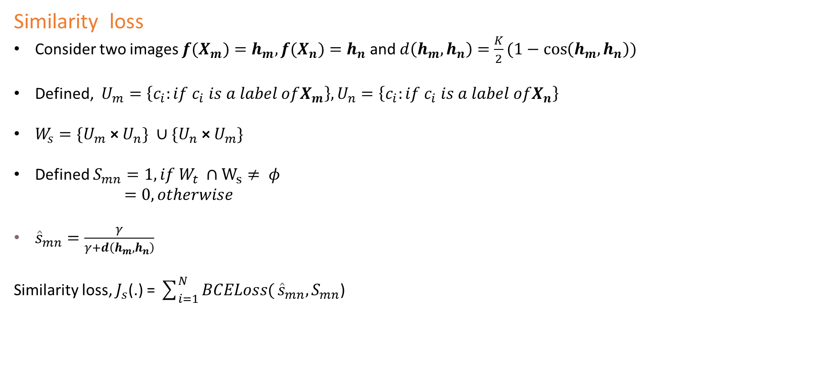
Indian Institute of Technology Kharagpur, India | Centre of Excellence in Artificial Intelligence
Solution
Similarity loss
Consider two images ${f(X}_{m})=h_{m},{f(X}_{n})=h_{n}$ and $d\left(h_{m}, h_{n}\right)=\frac{K}{2}(1−\cos\left(h_{m}, h_{n}\right))$
Defined, $U_{m}=\left\{c_{i}:if c_{i} is a label ofX_{m}\right\},U_{n}=\left\{c_{i}:if c_{i} is a label ofX_{n}\right\}$
$W_{s}=\{U_{m}$ × $U_{n}\} ∪\{U_{n}\text{ × }U_{m}\}$
Defined $S_{mn}=1, if W_{t} ∩W_{s}≠ φ$
$=0, otherwise$
${\hat{s}}_{mn}=\frac{γ}{γ+d\left(h_{m}, h_{n}\right)}$
Similarity loss, $J_{s}$(.) = $\sum_{i=1}^{N}{BCELoss(}{\hat{s}}_{mn},S_{mn}$)
04 February 2022
Hashing for multimorbidity | Asim Manna

Slide 8










Indian Institute of Technology Kharagpur, India | Centre of Excellence in Artificial Intelligence
Solution
Loss minimization and weight update
$$ℝ^{64×1}$$
$$ℝ^{M×M}$$
$${\hat{Y}}_{i}$$
$$X_{i}$$
netf (.)
fc(.)
$$ℝ^{K×1}$$
$$h_{i}$$
Tanh(.)
$$X_{j}$$
fc(.)
$$d\left(h_{i}, h_{j}\right)$$
$${\hat{s}}_{ij}$$
$$h_{j}$$
04 February 2022
CT Sinogram Denoising | Asim Manna

Slide 9
Indian Institute of Technology Kharagpur, India | Centre of Excellence in Artificial Intelligence
Base Line
Multi-label classification with ResNet50, MeDiANet
Retrieval with MeDiANet.
Fuzzy Inference System on input images (Paper1 , )
Deep multi-label hashing using Graph (Paper2
04 February 2022
CT Sinogram Denoising | Asim Manna

Slide 10
Indian Institute of Technology Kharagpur, India | Centre of Excellence in Artificial Intelligence
Multi-Disease Hashing
04 February 2022
CT Sinogram Denoising | Asim Manna

